Slide 1
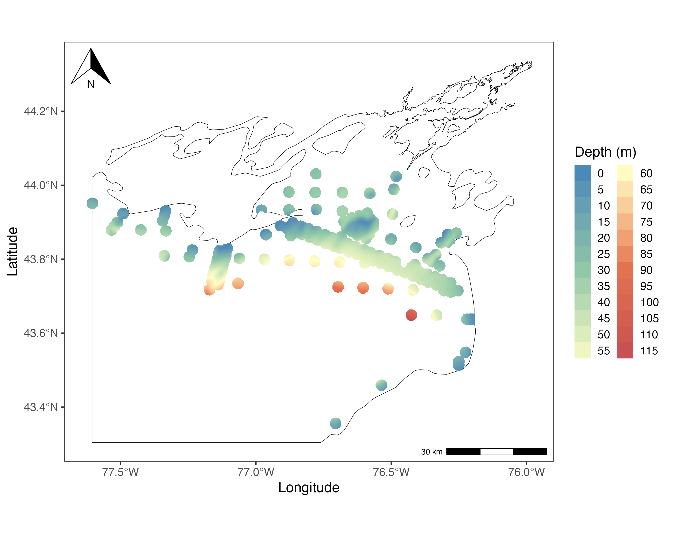
Bottom depth of Lake Ontario at 50% receiver range using Klinard et al. 2019.

Slide 2
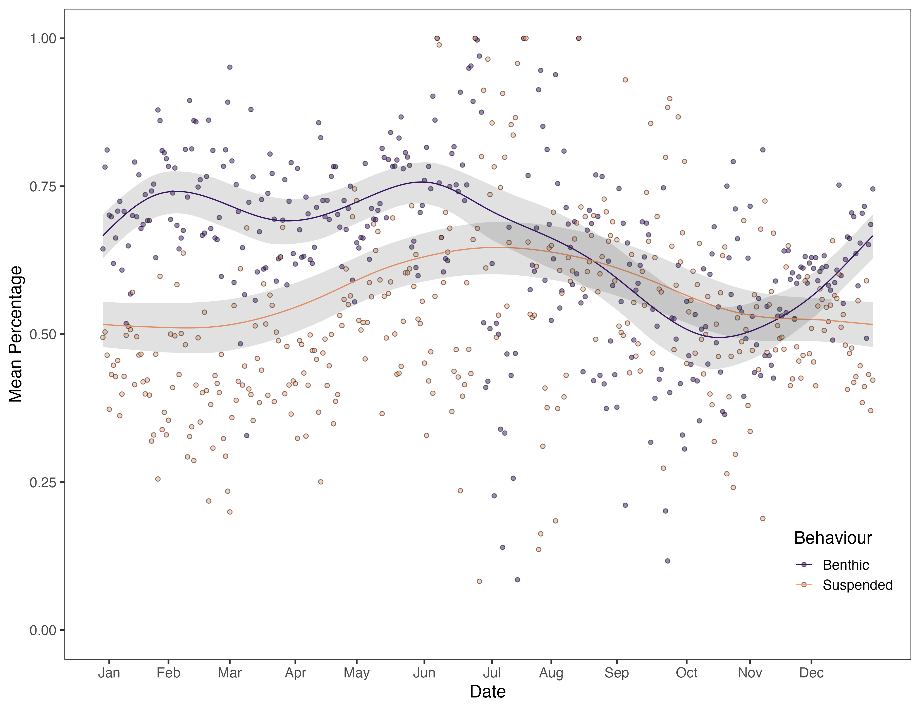
Average Percentage that a fish is Benthic or Suspended for each day

Slide 3
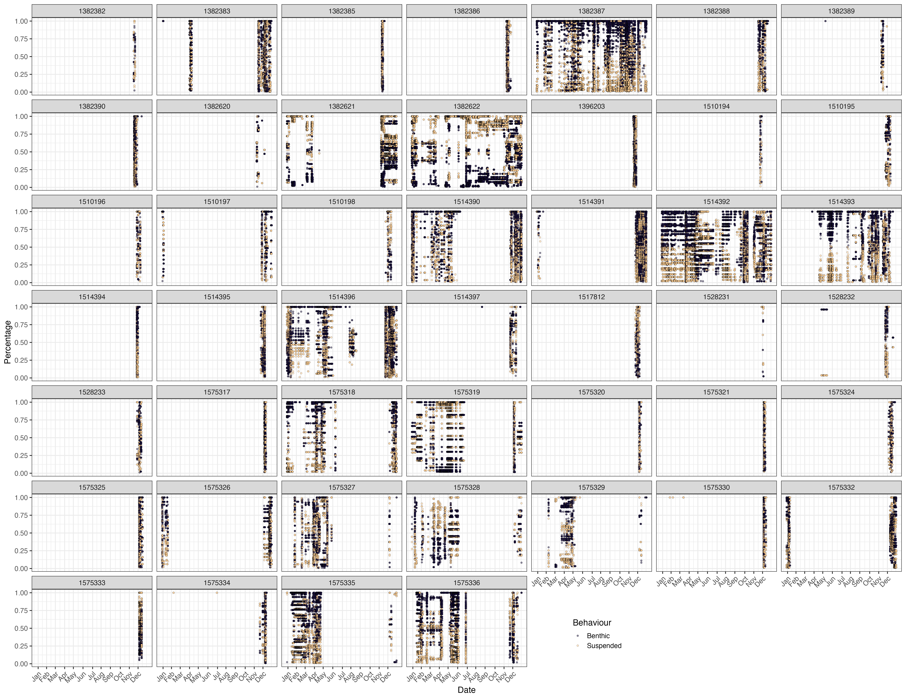
For each individual the percentage for each detection that it was benthic or pelagic

